Slide 1


Visualization Test – Naveen Kumar n

Slide 2
Goal
To Create a frame to cater to the organisation’s needs
Estimations and the time frame to work on this project
Capture the insights derived from the data visualization
Way forward

Slide 3
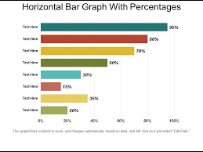
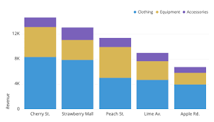
Planned Wire frame
KPI
KPI
KPI

Slide 4
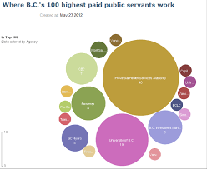
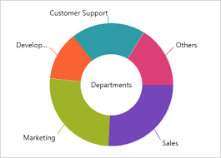
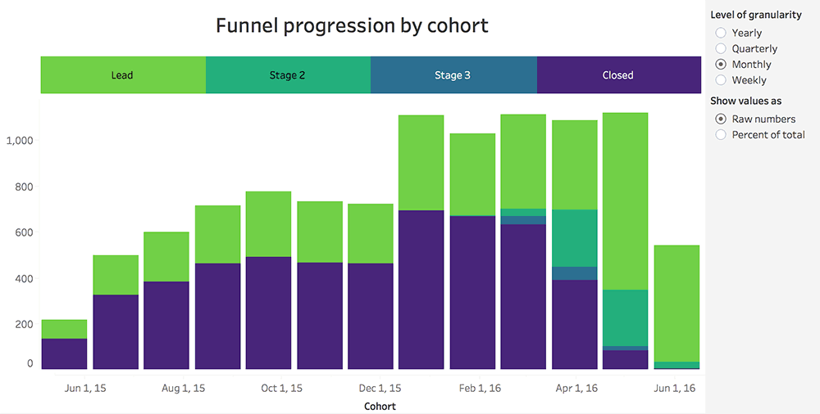
Pending Reports to be updated here
Insights and Way forwards

Slide 5
Cost and Duration Estimations
Sl No | Steps Involved | Time Required (Hours) | Cost per hour (Various based on the tasks) | Total Cost
1 | Understand the Requirements of the Clients | 2 | 300 | 600
2 | Project Charter Creation | 2 | 300 | 600
3 | Data collation & clean up | 2 | 200 | 400
4 | Creating KPI | 1 | 200 | 200
5 | Creating Sheets and Wireframe | 2 | 400 | 800
6 | Creating Dashboards | 3 | 500 | 1500
7 | Insights collation | 2 | 200 | 400
8 | Story Creations | 1 | 300 | 300
9 | Presentations to the clients | 1 | 500 | 500
10 | Corrections (if required) |  |  | 0
11 | Conclusion and Handover | 2 | 500 | 1000
12 | Cost of the tool | 0 | 5180 | 5180
13 | 18% of GST |  |  | 2066
Total |  | 18 (Hours) | 13546
The cost and duration estimation is subject to change based on the additional requirements
The tool cost is covered for the first month.
The organisation has to bare the cost of the tool from the 2nd month onwards
Training on the dashboard utilization will be provided to 1 SPOC from the organisation.
Additions on the number of SPOC would incur additional charges

